Slide 1
Geovisual Framework with NIBRS/Open Data for Novice Users
Michael Crowder
Lauren Darr
Gerardo Garza
Brent Allan

Slide 2
Is open data really open?
Open data should mean that data is open and available
While data is available is it really open to the public?

Slide 3
Is open data really open?
Open data should mean that data is open and available
While data is available is it really open to the public?
Is open data really open at all?
Yes and no
Does the public know what or how to use
Comma-separated values (.csv)
JavaScript Object Notation (JSON)
Application Programming Interface (API)

Slide 4
Is open data really open?
Not solving it today

Slide 5
Motivation behind Geovisual Framework
Two phase motivation
Open Data – data that is freely available for use and redistribution by anyone for any purpose. http://opendatahandbook.org/glossary/en/terms/open-data/

Slide 6
Motivation behind Geovisual Framework
Two phase motivation
Open Data – data that is freely available for use and redistribution by anyone for any purpose. http://opendatahandbook.org/glossary/en/terms/open-data/

Slide 7
Motivation behind Geovisual Framework
Two phase motivation
National Incident-Based Reporting System (NIBRS)
New crime reporting standard starting in 2021
Allows up to 10 offenses per incident
Higher level detail on less serious crimes

Slide 8
Motivation behind Geovisual Framework
Two phase motivation
National Incident-Based Reporting System (NIBRS)
New crime reporting standard starting in 2021
Allows up to 10 offenses per incident
Higher level detail on less serious crimes

Slide 9
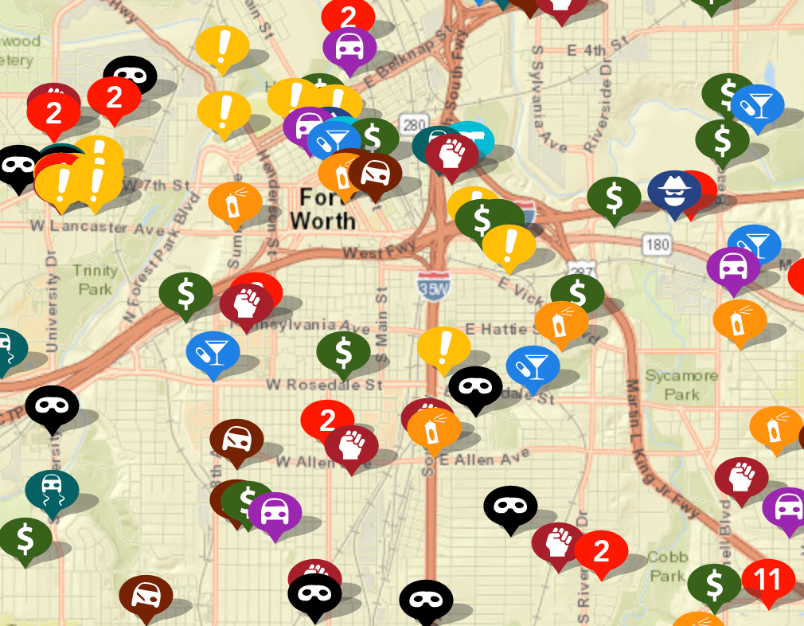
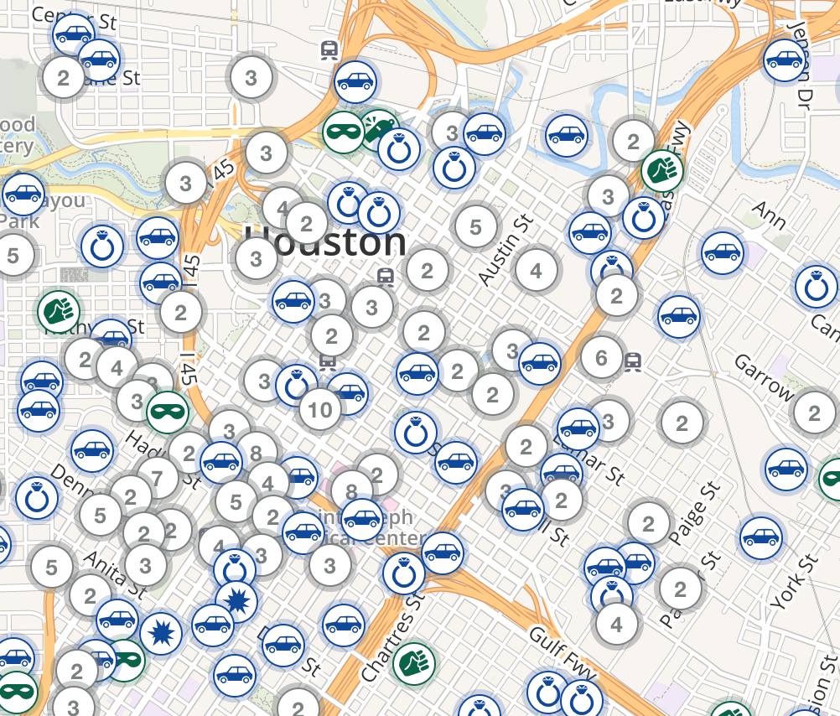
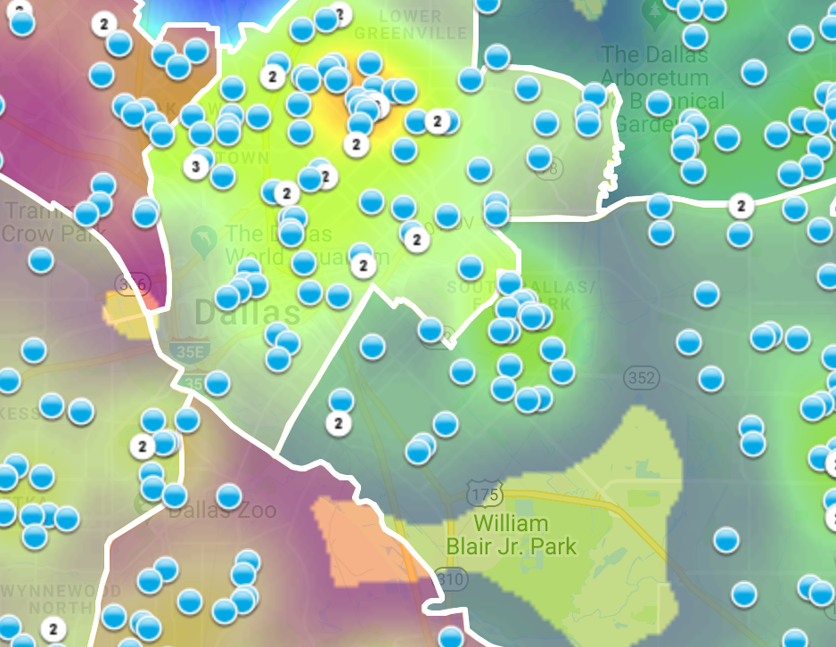
Motivation behind our Geovisual Framework
Currently, no standards exist for geovisual framework to display criminal activity on digital maps.
https://www.crimemapping.com/
https://www.crimereports.com
https:www.cityofirving.org

Slide 10
Data Source
Data source
City of Dallas Open Data Portal
Police Incident Data
386K Rows
103 Columns
2015 - 2018
Our mapping focuses on burglaries
Ability to segment
Not an overwhelming number like breaking into cars

Slide 11
Data Source
Data source
City of Dallas Open Data Portal
Police Incident Data
386K Rows
103 Columns
2015 - 2018
Our mapping focuses on burglaries
Ability to segment
Not an overwhelming number like breaking into cars

Slide 12
Map Making
Mapping handled through open-source products
R
Leaflet – Open-source JavaScript library

Slide 13
Map Making
Mapping handled through open-source products
R
Leaflet – Open-source JavaScript library

Slide 14
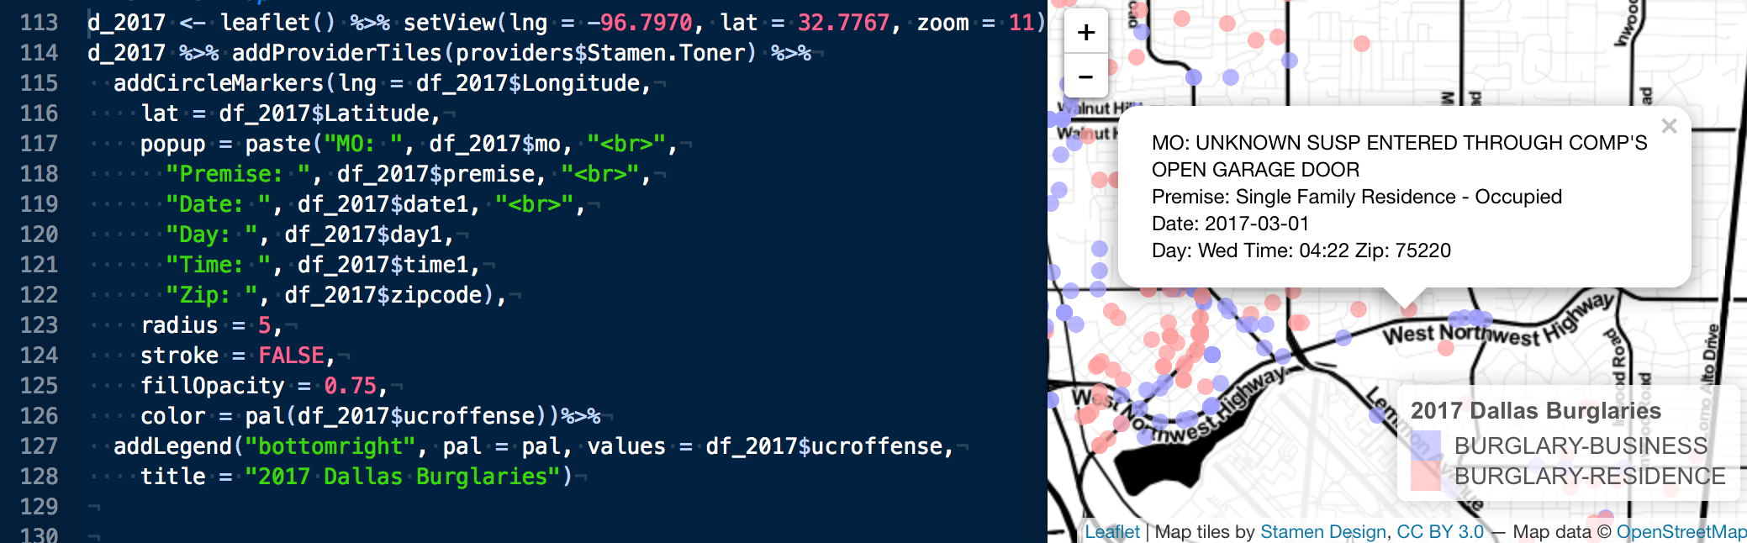
Map Making
Mapping handled through open-source products
R
Leaflet – Open-source JavaScript library

Slide 15
Hacking the Slide Format
Hacking the slide format is allowed
However,
The total number of slides
must be 21
The slides must transition automatically every 15 seconds
The aspect must be the standard format (not 16:9)
The footer information must be present and in the same position as this template

Slide 29
Last Slide
Fade to black after 15 seconds

